Slide 1

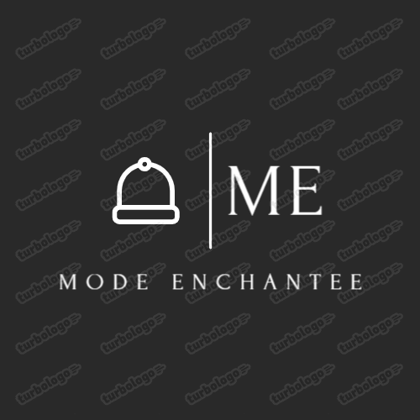


Mode Enchantee
An E-Commerce business website where your items are presented with defining features to attract consumers for it’s quality.

Slide 2

Mode Enchantee
Introduction
Welcome to Mode Enchantee – your destination for curated fashion that celebrates individuality and style. Discover a unique collection of clothing, accessories, and customizable designs that let you express yourself in the most enchanting ways. Whether you’re looking for timeless pieces or on-trend essentials, each item is crafted to elevate your wardrobe and embrace your personal flair. Explore endless possibilities to style, personalize, and make fashion your own. Step into a world where style knows no limits.

Slide 3
Mode Enchantee
Scope
As the developer of Mode Enchantée, the website's scope would encompass the following key areas, ensuring a seamless, engaging, and personalized shopping experience for users while also providing an efficient platform for business operations:

Slide 4


UX and Interface Design
Visually appealing and intuitive design
Personalized Shopping Experience
Search & Filtering
Create a clean, elegant, and modern interface that reflects the brand's identity. The website would have a chic, easy-to-navigate layout that feels immersive and user-friendly.
Users can create accounts and set up profiles with preferences to receive tailored product recommendations and style suggestions.
Advanced search functionality with filters (size, style, color, customization options, etc.) to help users quickly find the exact items they’re looking for.

Slide 5
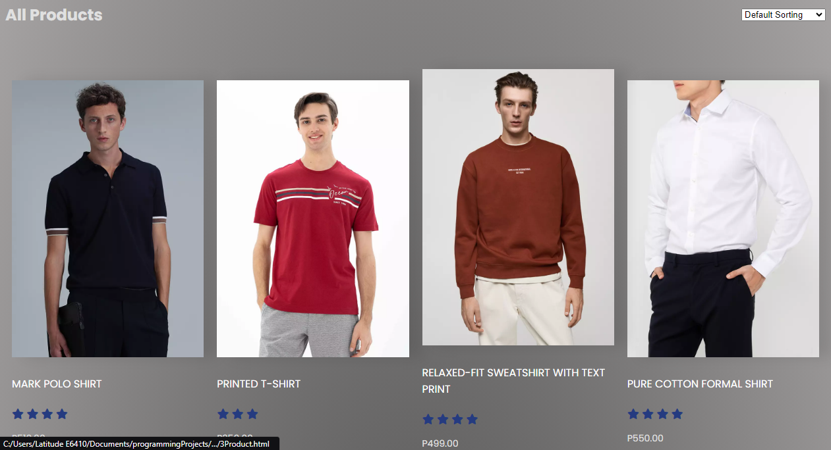

Slide 6
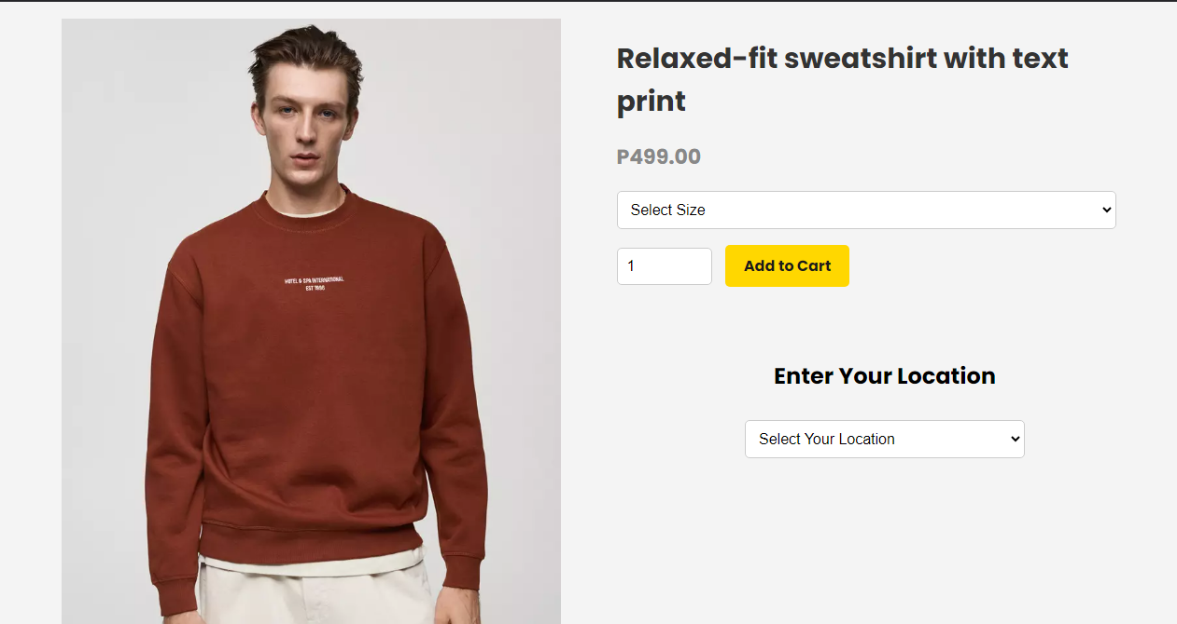

Slide 7
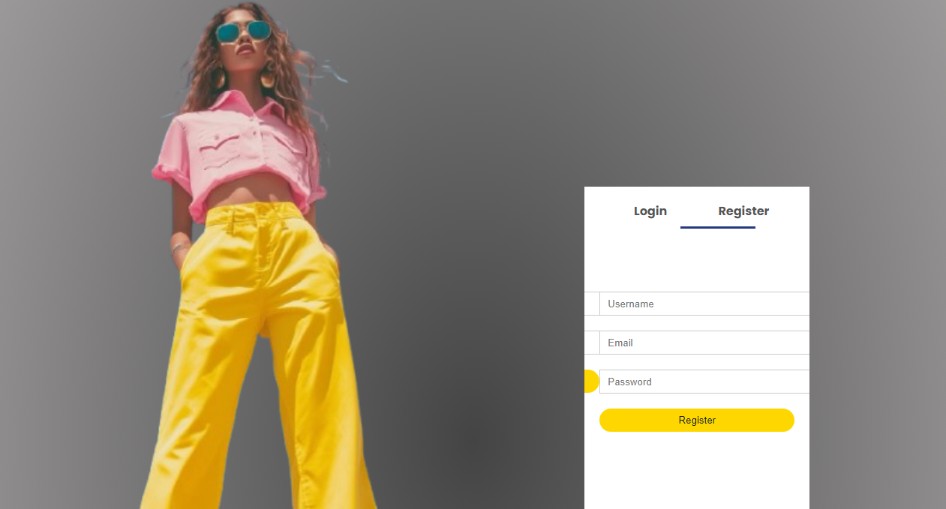
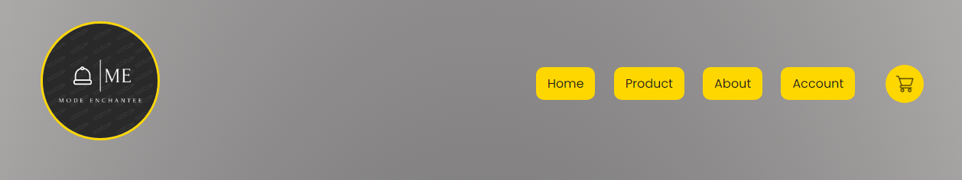

Slide 8

E-Commerce Features
Shopping Cart & Checkout Process
Multiple Payment Options
Easy-to-use cart with an intuitive, secure multi-step checkout system that supports multiple payment methods (credit/debit cards, PayPal, Apple Pay, etc.). Integration with payment gateways for a smooth checkout process.

Slide 9
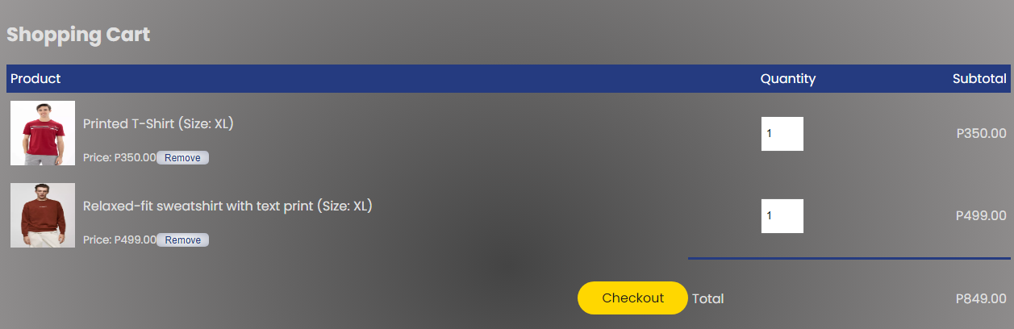
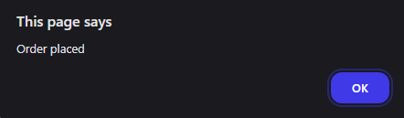

Slide 10
Strengths
Retention
How will you introduce your company to your potential customers? Examples: impressions, click-through rate, visits, and social media metrics.
How many of your customers are you retaining? Why are you losing others? Examples: customer acquisition rate and customer churn rate.
Acquisition
Revenue
Where are your potential customers coming from? What channel is driving the most valuable traffic for your company? Examples: new leads, email subscribers, resource downloads, support and sales chats.
Where are your potential customers coming from? What channel is driving the most valuable traffic for your company? Examples: new leads, email subscribers, resource downloads, support and sales chats.
Strengths
Referral
How will your potential customers try your product or service for the first time? How will you make them realize the true value of your product or service? Examples: new trial signups, product sales, activation after app download.
How can you turn your customers into advocates? What’s your systematic process to generate referrals consistently? Examples: Net Promoter Score, referrals, and social shares.

